Slide 1

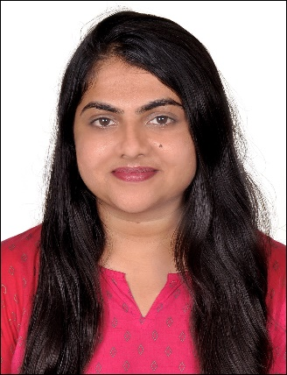


Preethika B N
Education and certificates
Bachelor of Engineering
Civil Engineering: 2017 - 2019
Analyst/Software Engineer
Skills
JAVA
Spring Boot
Spring Microservices
MONGODB
Angular
Base Location: ^{Bangalore}
Email ID:
PREETHIKA.B-N@capgemini.com
_{Mobile No:} +91 9483982453
Grade:
A4
Backend
Spring Boot
MongoDB
REST-API
NodeJS
Strengths
A self driven learner with Front-End and Back-End knowledge. Passionate about implementing and launching new projects.
Ready to learn new technologies/Frameworks and implement them to further improve my knowledge.
A team player with good communication skill always ready to work for the enrichment of knowledge.
Has working knowledge on Angular and Java Microservice Development using Spring framework on an intermediate level.
Achivement
Meesho App Clone
Completed end to end case study of Meesho App Clone System along with JWT authentication, using Spring boot Microservices with Eureka Server. Angular used for user interface.
Database
No SQL database – MongoDB
Completed Git, GitHub at Capgemini Degreed Platform
Web Technologies
HTML5 CSS3
Javascript/TypeScript
Learnt the concepts of Git and GitHub, simultaneously applied the concepts for better learning.
Pursuing iTransform:
Full Stack Angular, Spring Boot MS & MongoDB at Capgemini Degreed Platform.
AddOns Github Maven Postman
Also Implemented Eureka Server and API gateway in case study and upskilling day by day.
Additional Details
Excellent Communication Skills
Team Player
Presentation Title | Author | Date © Capgemini 2017. All rights reserved | 1

